Slide 1
Hash Analysis

Slide 2
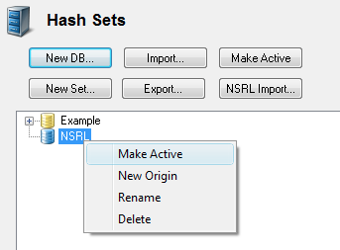
Objective
By the end of the module, participants will be able to use a hash set to identify known trusted and malicious files

Slide 3
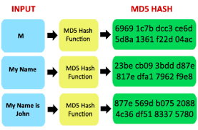
Hash Definition
Hashes:
Calculations or algorithms that result in unique value for each file or stream of data to which the calculation is applied

Slide 4
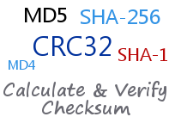
Hash Algorithm
The two key forensics hash algorithms are:
Message Digest 5 (128-bit value)
Secure Hash Algorithm 1 (160-bit value)
Two files with the same hash value are statistically likely to contain the same data

Slide 5
Hash Uses
Use |  | Process
Verify evidence file acquisitions |  | Compare acquisition and verification hash values
Identify known good files |  | Compare file hashes to libraries of known files
Identify known bad files |  | Compare file hashes to tables of known hashes

Slide 6

Hash Sets and Hash Libraries
Hash Set: A collection of hash values with similar traits
Hash Library: A collection of hash sets

Slide 7
Hash Analysis Process
Compare hash values to library
Choose a hash library
Generate a hash value for each file

Slide 8

Sources of Hash Sets
Forensic software vendors
U.S. National Institutes of Standards and Technology/National Software Reference Library
Specialized collections
Collections created by examiners/agencies

Slide 9
Known vs Unknown Files
Known files can be good or bad
Most files will be unknown
A forensic examiner must be capable of creating hash sets for local use
Notes:
Mention that often times files can’t be included in a hash library as such would exceed the scope of an authorized search. For example, if you are searching for evidence of a fraud, including contraband images in a hash library could exceed your search authorization.

Slide 10
EnCase
Evidence Processor

Slide 11
EnCase Evidence Processor
Hashing occurs during evidence processing with EnCase 7
EnCase Evidence Processor (EEP) provides hash analysis for files in the selected evidence items

Slide 12
Start Evidence Processor
Click Process Evidence

Slide 13
Red flag
Enable/disable
Start Evidence Processor
Click Process Evidence
Fixed option
Blue link

Slide 14
Blue link
Hash
Options
Notes:
Select one or both algorithms
Additional calculations affect processing time
Details appear on Hash Sets tab in View pane

Slide 15
Hash Single
or
Selected Files
Notes:
Highlight the file(s), right-click, open Entries, and select Hash\Sig Selected

Slide 16
Selected
Ignored
Size
Hash/Sign
Selected Menu
Notes:
Highlight the file(s), right-click, open Entries, and select Hash\Sig Selected

Slide 17
Home screen
Open Hash
Libraries
Hash Libraries

Slide 18
Primary
Library Enabled
Notes:
Edit the path, including network locations
The enabled path is saved as the default

Slide 19
Secondary
Library Enabled
Notes:
Edit the path, including network locations
The enabled path is saved as the default
EnCase 7 allows two active libraries
Highlight the secondary library and set a path

Slide 20
Blue check
Creating Hash Sets
From the Selected Files

Slide 21
Hash Library Type
Selecting Secondary Library for
New Hash Set
Notes:
Store custom hash sets in secondary library
Select existing hash sets or create a new one

Slide 22
Create New
Hash Set
Right click, New Hash Set
Notes:
Right-click and choose New hash set
Set the name, category, and tags
Select it in the Add in hash library menu

Slide 23
Create New
Hash Set
Name, Category, Tags
Notes:
Right-click and choose New hash set
Set the name, category, and tags
Select it in the Add in hash library menu

Slide 24
Check the Newly Created
Hash Set to Add Hashes
Select the New Set

Slide 25
Select the Newly Created Hash Set
To Enable in Hash Library
Notes:
Reopen the hash library and select new set
Reload entries view and refresh it
On Evidence tab, reopen case evidence

Slide 26
Boolean indicator
Hash Sets Created
and Visible
Notes:
Reopen the hash library and select new set
Reload entries view and refresh it
On Evidence tab, reopen case evidence

Slide 27
Using Hash Sets
Exclude files with known hashes from indexing and searching to save time
Locate files within hash categories using filters or conditions

Slide 28
Exclude File with Known Hashes from
Indexing and Searching
Blue link

Slide 29
Skip library files
Exclude File with Known Hashes from
Indexing and Searching
Blue link

Slide 30
Filter menu
Filter by
Hash Category

Slide 31
FTK Hash Analysis Features
FTK uses the term Known File Filter (KFF)
Hashing occurs during pre-processing
Results can be seen using KFF filter feature

Slide 32
FTK Evidence
Processing Options
Notes:
Adjust processing options
Results are displayed on the Overview tab

Slide 33
FTK Known File Filter (KFF)
Administration Menu
Notes:
Allows you to create additional hash groups or hash sets
Cannot modify or delete from Access Data

Slide 34
View results
FTK Known File Filter (KFF)
Alert Files
Notes:
Allows you to create additional hash groups or hash sets
Cannot modify or delete from Access Data

Slide 35
Summary
You should now be familiar with:
Identifying available sources of hash sets
Creating hash sets
Identifying known files using hash sets

Slide 36
Thanks!
Any questions?

